Slide 1
Topic 6:
Correlation
STOR 155: Introduction to Data Models and Inference
Dr. Teressa Bergland
Fall 2025

Slide 2
Announcements
Course PSAs:
Homework 4 due TODAY, Tuesday 2/03 on WebAssign
Homework 5 due TODAY, Tuesday 2/03 on WebAssign
Homework 6 due Thursday 2/05
First Midterm Exam: Thursday 2/12
Warm-Up:
Linear association recap!

Slide 3
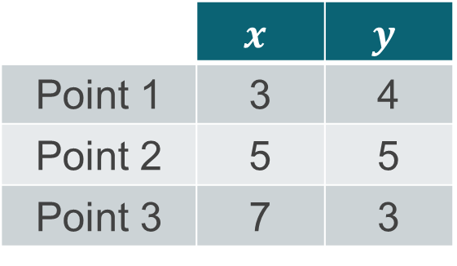

Correlation
The correlation coefficient $r$:
$$r=\frac{1}{n−1}\sum_{i=1}^{n}{\left(\frac{x_{i}−\overline{x}}{s_{x}}\right)\left(\frac{y_{i}−\overline{y}}{s_{y}}\right)}$$
Let’s practice! For this data, $r=−\frac{1}{2}$
 | $$x$$ | $$y$$
Point 1 | 3 | 4
Point 2 | 5 | 5
Point 3 | 7 | 3

Slide 4

Properties of Correlation
Possible values
Sign meaning
$r$ does not change even if…
A note on outliers

Slide 5
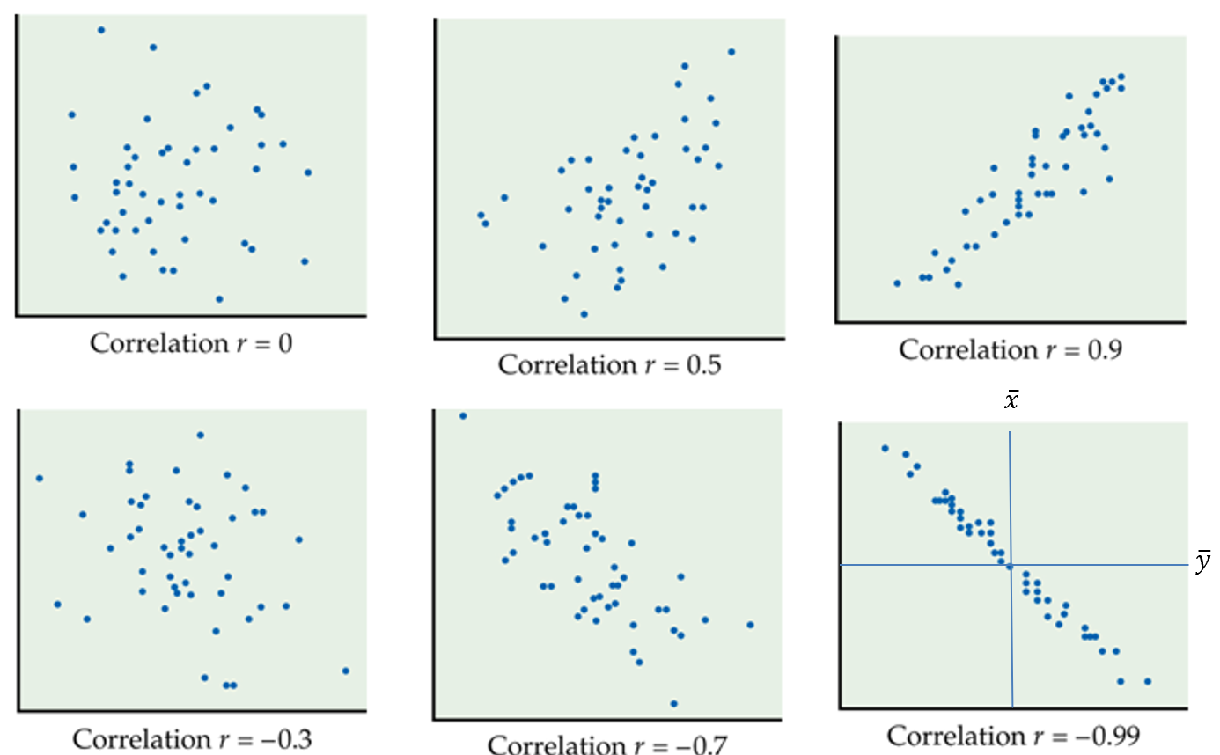
Some Examples

Slide 6
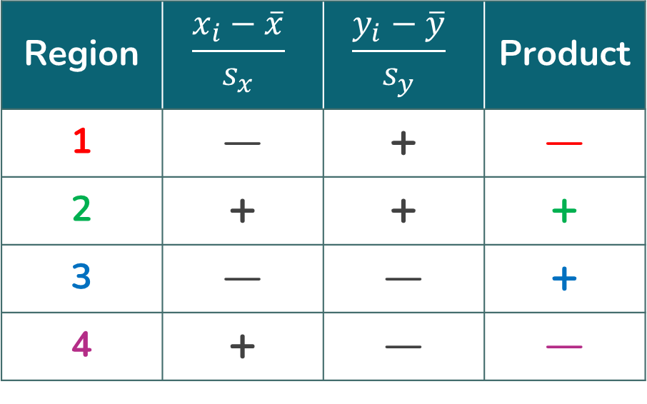

Contributions to Correlation
$$r=\frac{1}{n−1}\sum_{i=1}^{n}{\left(\frac{x_{i}−\overline{x}}{s_{x}}\right)\left(\frac{y_{i}−\overline{y}}{s_{y}}\right)}$$
Region | $$\frac{x_{i}−\overline{x}}{s_{x}}$$ | $$\frac{y_{i}−\overline{y}}{s_{y}}$$ | Product
1 | — | + | —
2 | + | + | +
3 | — | — | +
4 | + | — | —
1
2
3
4

Slide 7
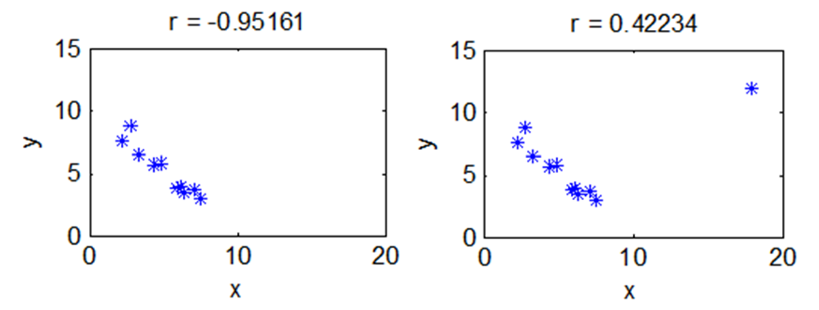
Outlier Distortion

Slide 8
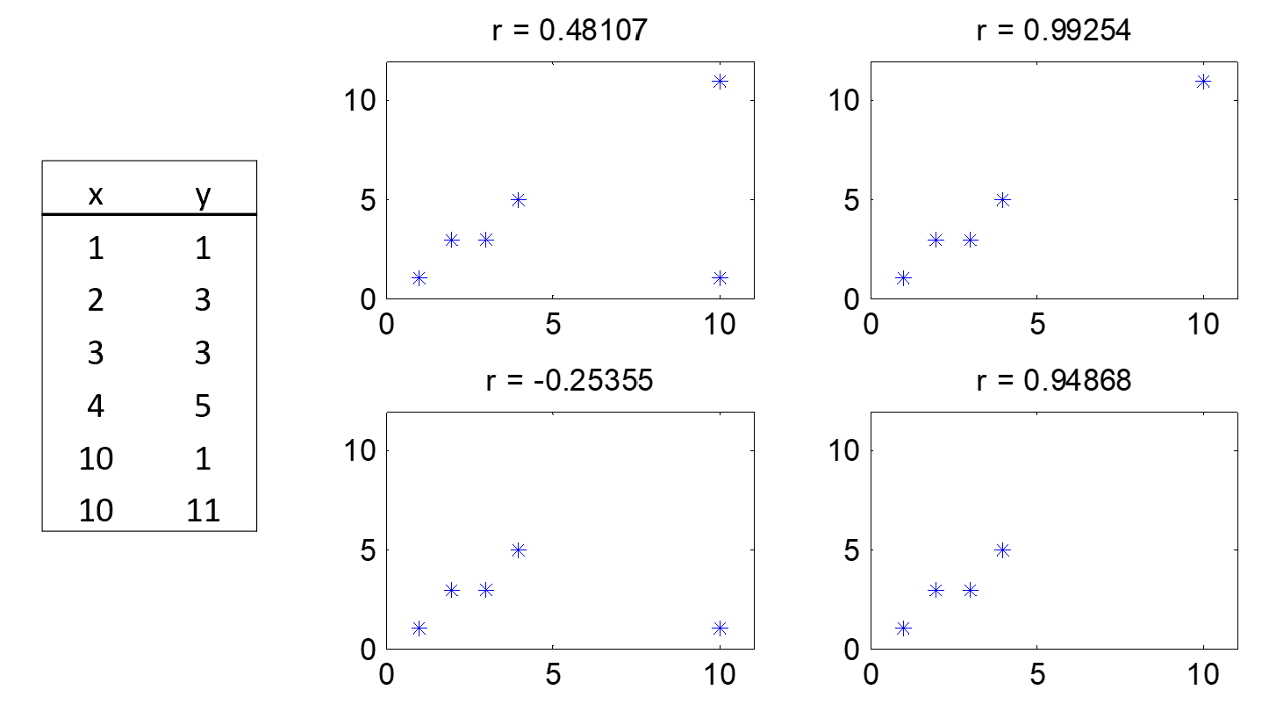
Outlier Distortion

Slide 9
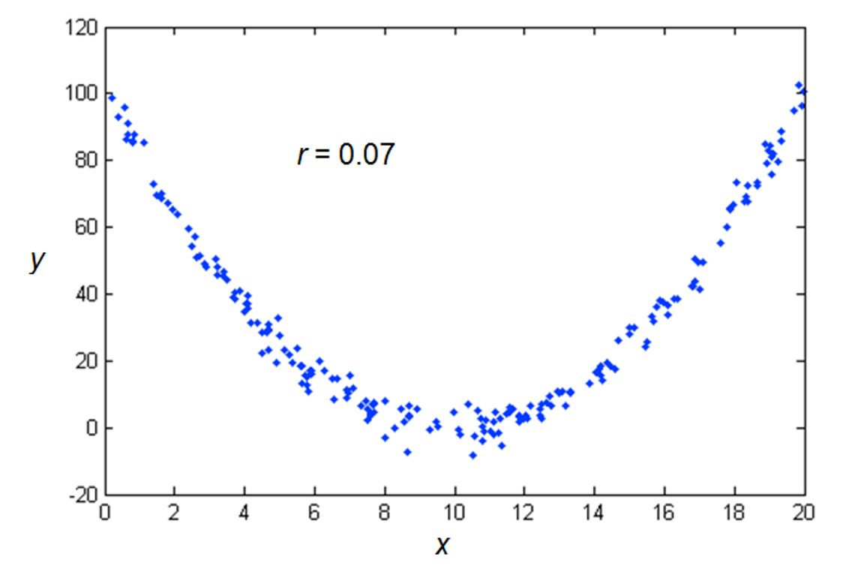
Correlation and Nonlinear Association

Slide 10
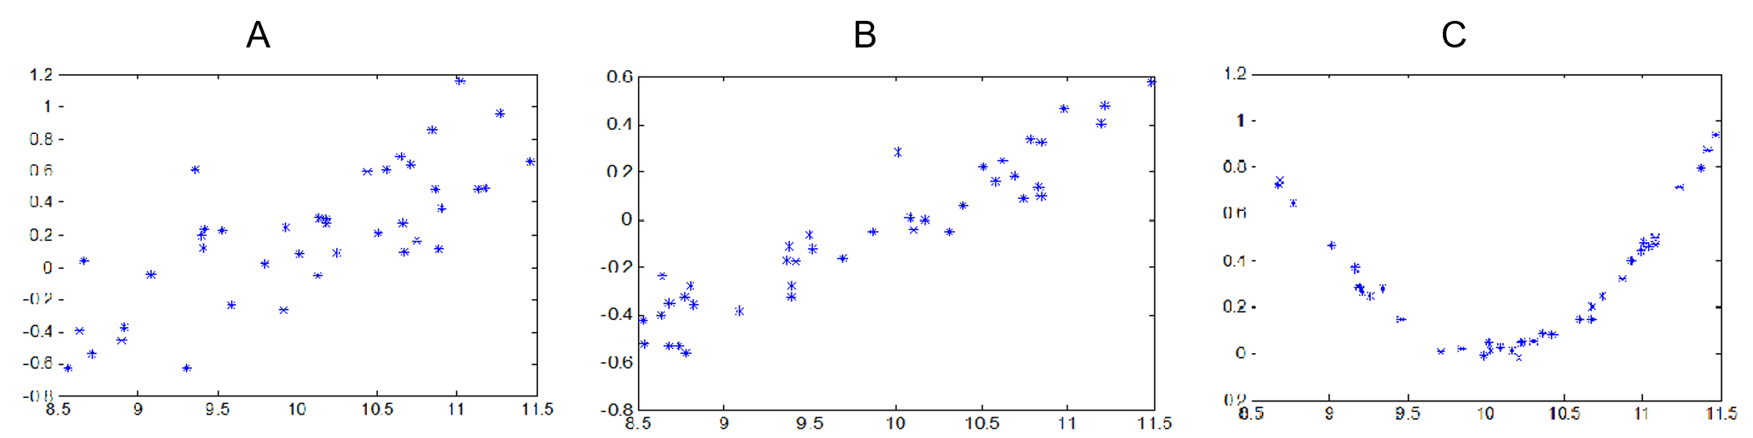
Sanity Check!
Which of these has the correlation closest to +1?

Slide 11
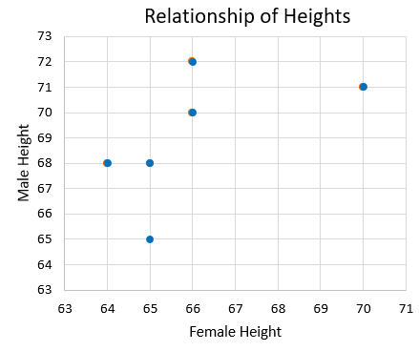
Let’s Practice! Heights of Couples

Slide 12
Let’s Practice! Heights of Couples
Effect on correlation if all men were 6 inches shorter? Conclusions about dating tendencies?
Effect on correlation if heights were in centimeters?
Correlation if each woman dated a man exactly 3 inches taller than she is?

